Slide 1

WELCOME TO THE VERY FIRST WORKSHOP IN MLDA DEEP LEARNING WEEK!

Slide 2
MLDA@EEE DEEP LEARNING WEEK FLOW
Text Generator Using RNN
Intro to CNN
Intro to Reinforcement Learning
Transfer Learning

Slide 3
In this workshop, we assumed that…
You have attended the workshops in pre-deep learning week...
OR
Have basic knowledge of python programming, deep learning as well as neural network…
OR?
…

Slide 4

TEXT GENERATOR USING RNN
MLDA DEEP LEARNING WK SPECIAL:
SPEAKER:
RAO YUCHEN
IEM/YR3

Slide 5
STRUCTURE
Development of NLP
What is NLP?
Why NLP?
Text Processing Basics
RNN Basics
What is RNN?
Structure of RNN
Improvement over RNN
Extended Reading
Intro to Practical Session
PRACTICAL SESSION

Slide 6

1-1 WHAT IS NLP?
Natural Language Processing is a field of Artificial Intelligence that gives the machines the ability to read, understand and derive meaning from human languages.
A high-level standard workflow for any NLP project
https://towardsdatascience.com/a-practitioners-guide-to-natural-language-processing-part-i-processing-understanding-text-9f4abfd13e72

Slide 7
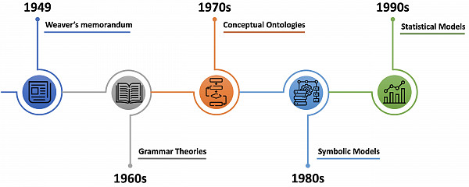
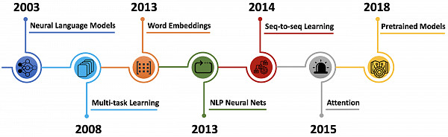
https://www.websystemer.no/a-brief-history-of-natural-language-processing%E2%80%8A-%E2%80%8Apart-2/
Notes:
NLP is originated from the idea of Machine Translation (MT). The primary idea was to convert one human language to another human language using the brain of the Computers but after that, the thought of conversion of human language to computer language and vice-versa emerged, so that communication with the machine became easy.
They are full of passion at the beginning and they believe that fully automatic high quality translation systems would be able to produce results indistinguishable from those of human translators.
But… things are not that easy given the conditions back to 1960s, they are not able to perform better and cheaper than simply inviting a human translator.
70s conceptual ontologies – convert real information into machine understandable language
80s, with the symbolic Models (so called complex hard-coded rules and grammars to parse language) to analyse the word and char meaning
90s, that statistical models came as a revolution in NLP, replacing most natural language processing systems based on complex sets of hand-written rules. decision trees
first neural language model, that consists of a one-hidden layer feed-forward neural network, introduce what is now referred as word embedding, a real-valued word feature vector in R^d. More precisely, their model took as input vector representations of the n previous words, which were looked up in a table learned together with the model. The vectors were fed into a hidden layer, whose output was then provided to a softmax layer that predicted the next word of the sequence.
In 2013, Mikolov et al. introduced arguably the most popular word embedding model: Word2Vec. Although dense vector representations of words have been used as early as 2003 (Bengio et al.), the main innovation proposed in their paper was an efficient improvement of the training procedure, by removing the hidden layer and approximating the objective.
The year 2013 also marked the adoption of neural network models in NLP, in particular three well-defined types of neural networks: recurrent neural networks (RNNs; Elman, 1990), convolutional neural networks (CNNs), and recursive neural networks (Socher et al., 2013). Because of their architecture, RNNs became popular for dealing with the dynamic input sequences ubiquitous in NLP.
In 2014, Sutskever et al. proposed sequence-to-sequence learning, a general end-to-end approach for mapping one sequence to another using a neural network.
In 2015, Bahdanau et al. introduced the principle of attention, which is one of the core innovations in neural machine translation (NMT) and the key idea that enabled NMT models to outperform classic sentence-based MT systems. It basically alleviates the main bottleneck of sequence-to-sequence learning, which is its requirement to compress the entire content of the source sequence into a fixed-size vector. Indeed, attention allows the decoder to look back at the source sequence hidden states, that are then combined through a weighted average and provided as additional input to the decoder. Attention is potentially useful for any task that requires making decisions based on certain parts of the input.
The latest major innovation in the world of NLP is undoubtedly large pretrained language models. , which have shown to enable efficient learning with significantly less data. The main advantage of these pre-trained language models comes from their ability to learn word representations from large unannotated text corpora, which is particularly beneficial for low-resource languages where labelled data is scarce.

Slide 8






1-2 WHY NLP? – Uses of nlp IN OUR LIFE
Customer Services
Health care
Recruitment
Spam Detection
Sentiment Analysis
Conversational Framework
Notes:
Nowadays everybody wants the machine to talk, and the only way by which a computer can speak is through Natural Language Processing (NLP).
NLP in health care – Amazon Comprehend Medical services which are used to extract the disease conditions, can handle meditations sessions and can monitor the results of the treatment using clinical trial reports, electronic health records and using patient notes. This is an example of NLP in health analytics where using NLP the prediction of different diseases is possible using pattern recognition methods and patient ‘s speech and their electronic health record.
Sentiment Analysis using NLP – The companies and organizations are now concentrating on the different ways to know their customers so that a personalized touch can be provided. Using sentiment analysis (which is possible only using NLP) the sentiments behind the words can be determined. The sentiment analysis has the capabilities to offer a lot of knowledge about the customer’s behavior and their choices which can be considered as significant decision drivers.
Spam Detection – The giants of the technical world such as Google and Yahoo use NLP to classify and filter out the emails which are suspected to be spam. This process is known as Spam Detection and Spam Filtering respectively. It results in an automated process which can classify the email as spam and stop it for entering the Inbox.
NLP in Recruitment – NLP can also be used in both search and selection phases of Job Recruitment, in fact, the chatbot can also be used to handle the job-related query at Initial level which also includes identifying the required skills for a specific job and handling initial level tests and exams.
Conversational Framework – This technology and the devices related to it are gaining so much popularity these days. Alexa which was illustrated above is one of them, but there are Apple’s Siri and Google‘s Ok Google which are the examples of the same sort of technology use cases.

Slide 9
1-3 NLP BASICS FOR TEXT
Tokenization (Text to Words)
Tokenization is a way of separating a piece of text into smaller units called tokens.
I love machine learning.
Word Tokenization: [‘i’, ‘love’, ‘machine’, ‘learning’]
Character Tokenization: i- -l-o-v-e- -m-a-…
Sub-word Tokenization: i-lov-e-mach-ine-learn-ing
Corpus
A language resource consisting of a large and structured set of texts

Slide 10
1-3 NLP BASICS FOR TEXT
Stopwords: stopwords are the words in any language which does not add much meaning to a sentence.
You are now listening to my workshop…
=> [now, listening, workshop]
Padding: All the neural networks require to have inputs that have the same shape and size but not all the sentences have the same length.

Slide 11
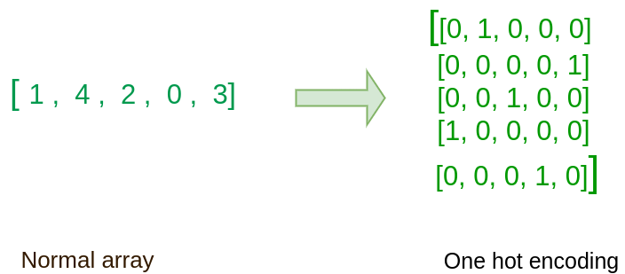
1-3 NLP BASICS FOR TEXT
One-hot vectors
The one-hot vectors’ dimension the number of unique words in the dictionary.

Slide 12
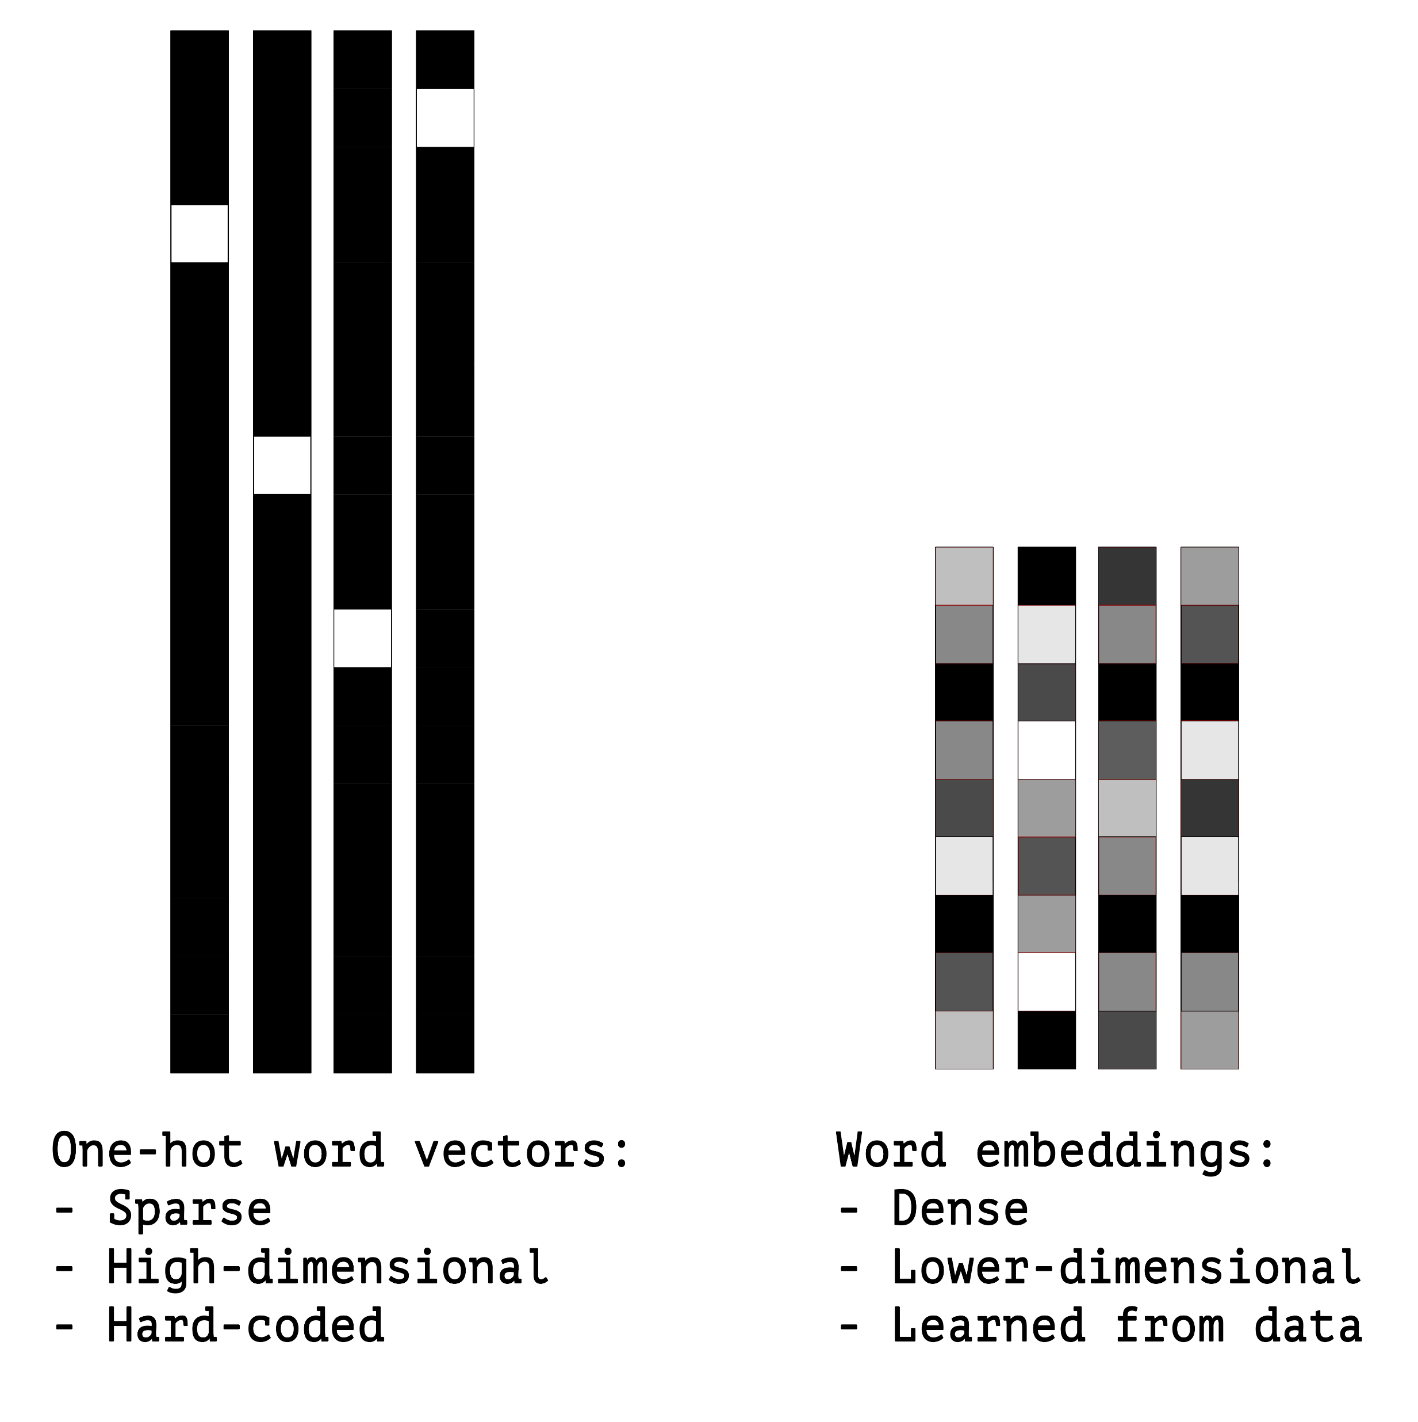
1-3 NLP BASICS FOR TEXT
Word Embedding (Word2Vec)
A word embedding is a class of approaches for representing words and documents using a dense vector representation.
The position of a word within the vector space is learned from text and is based on the words that surround the word when it is used.

Slide 13
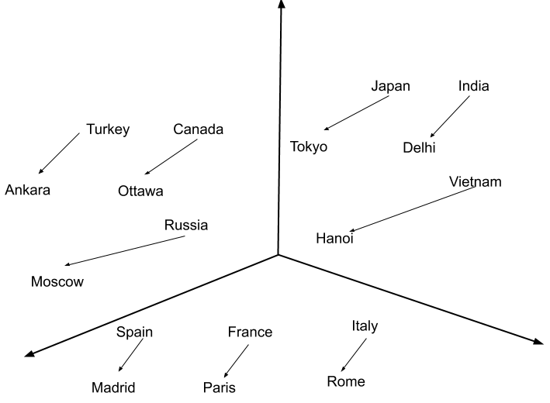
KERAS Embedding Layer
Keras offers an Embedding layer that can be used for neural networks on text data.
In Keras, the Embedding layer automatically takes inputs with the category indices and converts them into dense vectors.
Embedding(input_dim=VOCAB_SIZE,
output_dim=EMBEDDING_SIZE, input_length=MAX_SEQUENCE_LENGTH))
https://androidkt.com/how-embedding-layer-work-in-keras/

Slide 14
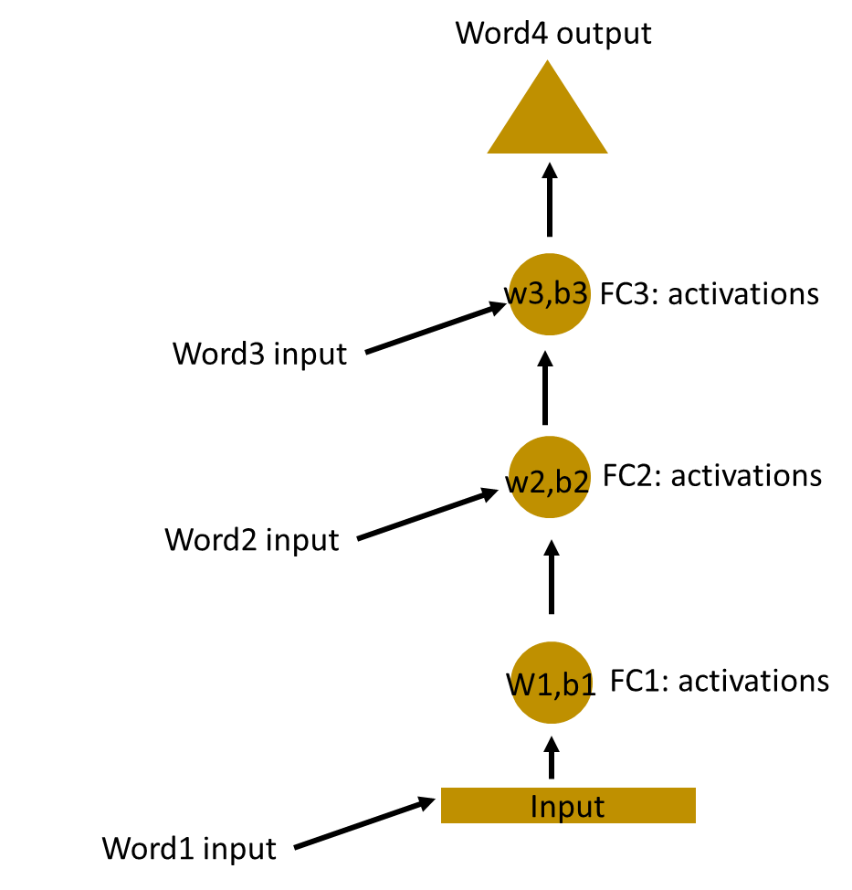
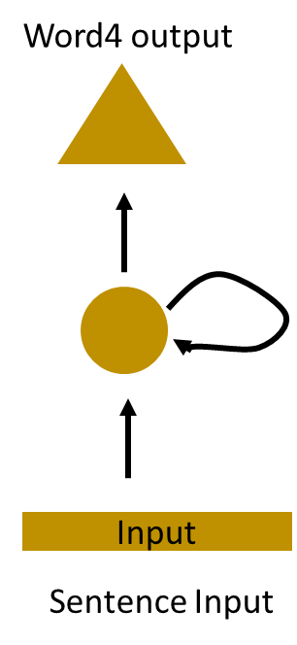
2-1 WHAT IS RNN?
deep this love but love workshop I learning I don’t
I don’t love deep learning but I love this workshop
I love deep learning but I don’t love this workshop
Recurrent Neural Network(RNN) are a type of Neural Network where the output from previous step are fed as input to the current step.
https://www.analyticsvidhya.com/blog/2017/12/introduction-to-recurrent-neural-networks/
Notes:
Recurrent Neural Network(RNN) are a type of Neural Network where the output from previous step are fed as input to the current step. In traditional neural networks, all the inputs and outputs are independent of each other, but in cases like when it is required to predict the next word of a sentence, the previous words are required and hence there is a need to remember the previous words. Thus RNN came into existence, which solved this issue with the help of a Hidden Layer. The main and most important feature of RNN is Hidden state, which remembers some information about a sequence.

Slide 15
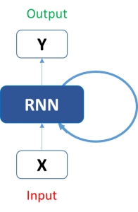
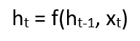
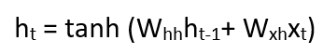
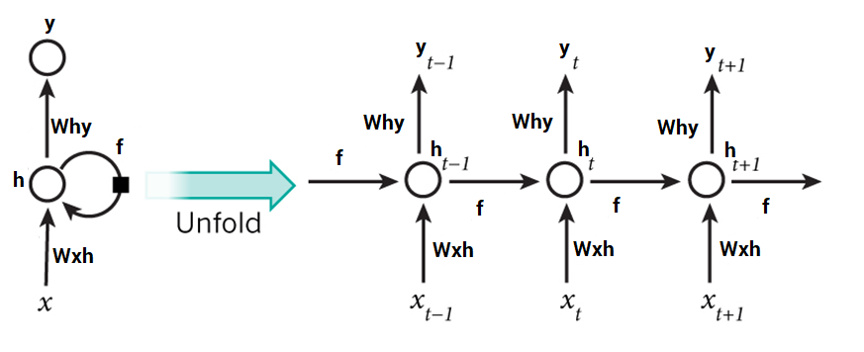
2-2-1 STRUCTURE OF RNN
https://www.analyticsvidhya.com/blog/2017/12/introduction-to-recurrent-neural-networks/
Notes:
Here, Ht is the new state, ht-1 is the previous state while xt is the current input. We now have a state of the previous input instead of the input itself, because the input neuron would have applied the transformations on our previous input. So each successive input is called as a time step.
In this case we have four inputs to be given to the network, during a recurrence formula, the same function and the same weights are applied to the network at each time step.
Taking the simplest form of a recurrent neural network, let’s say that the activation function is tanh, the weight at the recurrent neuron is Whh and the weight at the input neuron is Wxh, we can write the equation for the state at time t as –
The Recurrent neuron in this case is just taking the immediate previous state into consideration. For longer sequences the equation can involve multiple such states. Once the final state is calculated we can go on to produce the output
Now, once the current state is calculated we can calculate the output state as-
concati

Slide 16
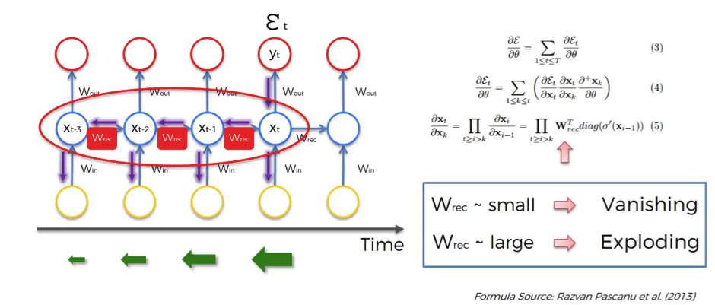
2-2-2 VANISHING GRADIENT PROBLEM
BLUE
The colour of the sky is __ __.
I spent over 20 years living in a small village in France. I then moved to Germany.
…… (100 lines)
But I can’t really speak fluent _______.
German
https://www.superdatascience.com/recurrent-neural-networks-rnn-the-vanishing-gradient-problem/
Notes:
The lower the gradient is, the harder it is for the network to update the weights and the longer it takes to get to the final result.
For instance, 1000 epochs might be enough to get the final weight for the time point t, but insufficient for training the weights for the time point t-3 due to a very low gradient at this point. However, the problem is not only that half of the network is not trained properly.
The output of the earlier layers is used as the input for the further layers. Thus, the training for the time point t is happening all along based on inputs that are coming from untrained layers. So, because of the vanishing gradient, the whole network is not being trained properly.
To sum up, if wrec is small, you have vanishing gradient problem, and if wrec is large, you have exploding gradient problem.
For the vanishing gradient problem, the further you go through the network, the lower your gradient is and the harder it is to train the weights, which has a domino effect on all of the further weights throughout the network.
That was the main roadblock to using Recurrent Neural Networks. But let’s now check what are the possible solutions to this problem.

Slide 17
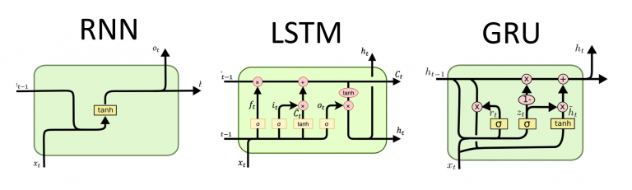
2-3 Improvement over VANILLA RNN
LONG-SHORT TERM MEMORY
GATED RECURRENT UNIT
Notes:
Vanishing gradient problem is far more threatening as compared to the exploding gradient problem, where the gradients become very very large due to a single or multiple gradient values becoming very high.
The reason why Vanishing gradient problem is more concerning is that an exploding gradient problem can be easily solved by clipping the gradients at a predefined threshold value. Fortunately there are ways to handle vanishing gradient problem as well. There are architectures like the LSTM(Long Short term memory) and the GRU(Gated Recurrent Units) which can be used to deal with the vanishing gradient problem.
With the recent breakthroughs that have been happening in data science, it is found that for almost all of these sequence prediction problems, Long short Term Memory networks, a.k.a LSTMs have been observed as the most effective solution.
LSTMs have an edge over conventional feed-forward neural networks and RNN in many ways. This is because of their property of selectively remembering patterns for long durations of time. The purpose of this article is to explain LSTM and enable you to use it in real life problems. Let’s have a look!

Slide 18
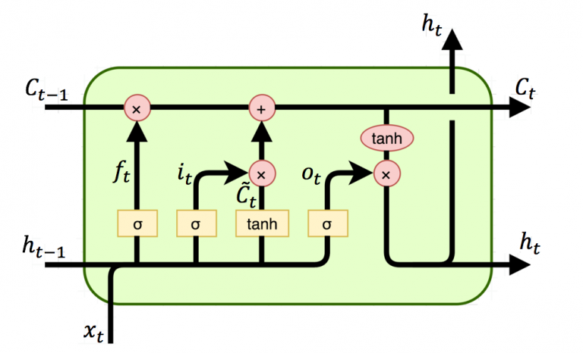
LSTM
Notes:
Then later, LSTM (long short term memory) was invented to solve this issue by explicitly introducing a memory unit, called the cell into the network. This is the diagram of a LSTM building block.
At a first sight, this looks intimidating. Let’s ignore the internals, but only look at the inputs and outputs of the unit. The network takes three inputs. X_t is the input of the current time step. h_t-1 is the output from the previous LSTM unit and C_t-1 is the “memory” of the previous unit, which I think is the most important input. As for outputs, h_t is the output of the current network. C_t is the memory of the current unit.
On the LSTM diagram, the top “pipe” is the memory pipe. The input is the old memory (a vector). The first cross ✖ it passes through is the forget valve. It is actually an element-wise multiplication operation. So if you multiply the old memory C_t-1 with a vector that is close to 0, that means you want to forget most of the old memory. You let the old memory goes through, if your forget valve equals 1. Now the second valve is called the new memory valve. Again, it is a one layer simple neural network that takes the same inputs as the forget valve. This valve controls how much the new memory should influence the old memory.

Slide 19
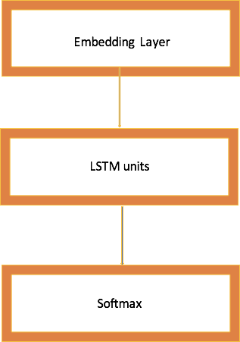
2-3 KERAS LSTM EXAMPLE
embedding_dim = 32
word_num = 2000
state_dim = 32
model = Sequential()
model.add(Embedding(vocabulary, embedding_dim, input_length=word_num-1))
model.add(LSTM(state_dim))
model.add(Dense(word_num,activation='softmax'))
model.compile(loss = 'categorical_crossentropy', optimizer='adam',metrics = ['accuracy'])

Slide 20
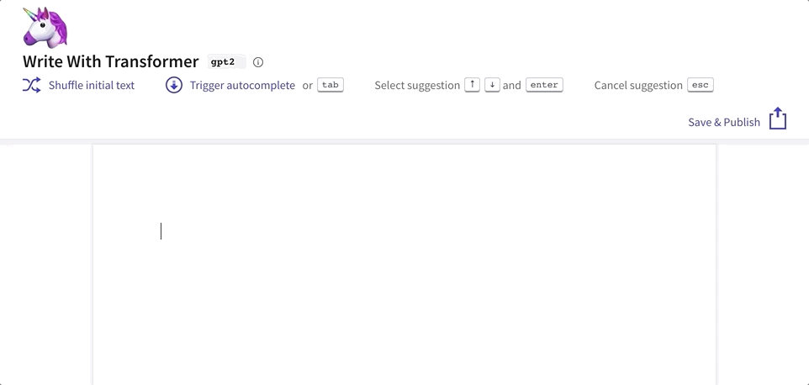
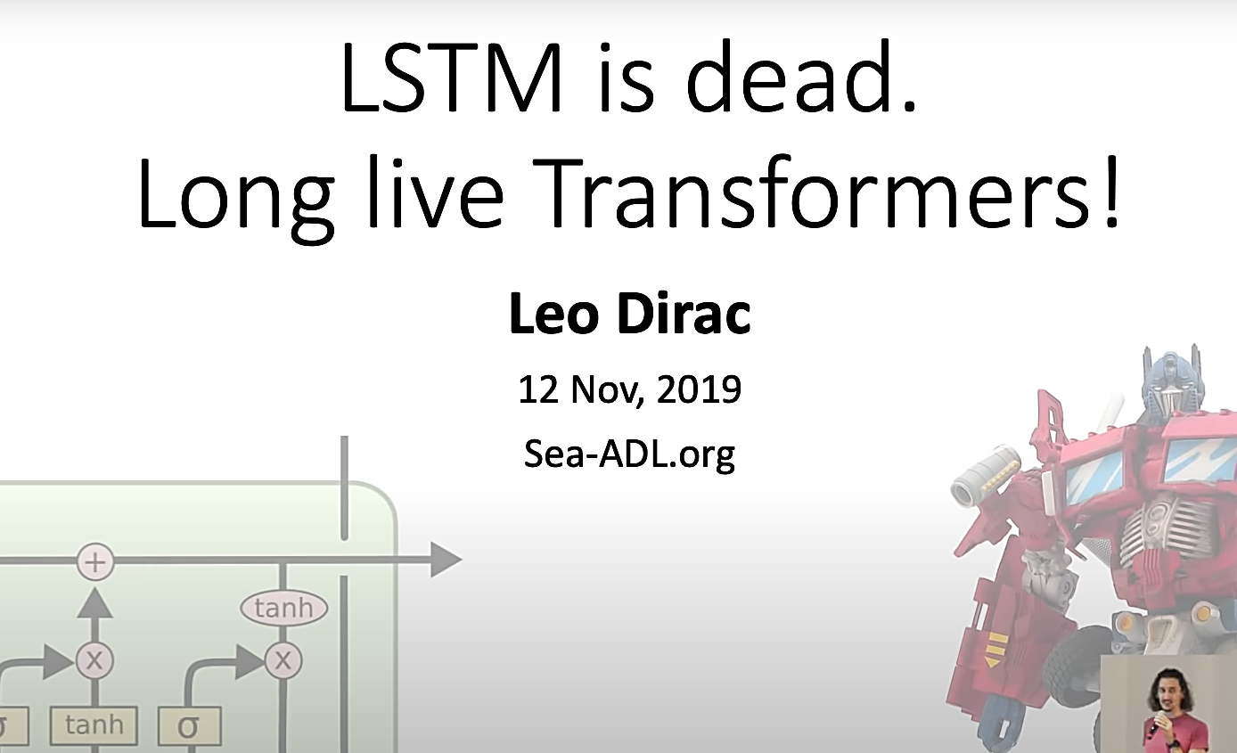
3 EXTENDED READING
Pretrained NLP Models
Multi-Purpose NLP Models
ULMFiT
Transformer
Google’s BERT
Transformer-XL
OpenAI’s GPT-2
Word Embeddings
ELMo
Flair
Other Pretrained Models
StanfordNLP
Transformers
Notes:
The Transformer in NLP is a novel architecture that aims to solve sequence-to-sequence tasks while handling long-range dependencies with ease. The Transformer was proposed in the paper Attention Is All You Need. It is recommended reading for anyone interested in NLP.
Quoting from the paper:
“The Transformer is the first transduction model relying entirely on self-attention to compute representations of its input and output without using sequence-aligned RNNs or convolution.”
The idea behind Transformer is to handle the dependencies between input and output with attention and recurrence completely.
In short, this is a wonderful time to be involved in the NLP domain.
This rapid increase in NLP adoption has happened largely thanks to the concept of transfer learning enabled through pretrained models. Transfer learning, in the context of NLP, is essentially the ability to train a model on one dataset and then adapt that model to perform different NLP functions on a different dataset.
This breakthrough has made things incredibly easy and simple for everyone, especially folks who don’t have the time or resources to build NLP models from scratch. It’s perfect for beginners as well who want to learn or transition into NLP.
Why use pretrained models?
The author(s) has already put in the effort to design a benchmark model for you! Instead of building a model from scratch to solve a similar NLP problem, we can use that pretrained model on our own NLP dataset
A bit of fine-tuning will be required but it saves us a ton of time and computational resources
In this article, I have showcased the top pretrained models you can use to start your NLP journey and replicate the state-of-the-art research in this field. You can check out my article on the top pretrained models in Computer Vision here.
In 2015, Bahdanau et al. introduced the principle of attention, which is one of the core innovations in neural machine translation (NMT) and the key idea that enabled NMT models to outperform classic sentence-based MT systems. It basically alleviates the main bottleneck of sequence-to-sequence learning, which is its requirement to compress the entire content of the source sequence into a fixed-size vector. Indeed, attention allows the decoder to look back at the source sequence hidden states, that are then combined through a weighted average and provided as additional input to the decoder. Attention is potentially useful for any task that requires making decisions based on certain parts of the input.
The latest major innovation in the world of NLP is undoubtedly large pretrained language models. , which have shown to enable efficient learning with significantly less data. The main advantage of these pre-trained language models comes from their ability to learn word representations from large unannotated text corpora, which is particularly beneficial for low-resource languages where labelled data is scarce.

Slide 21
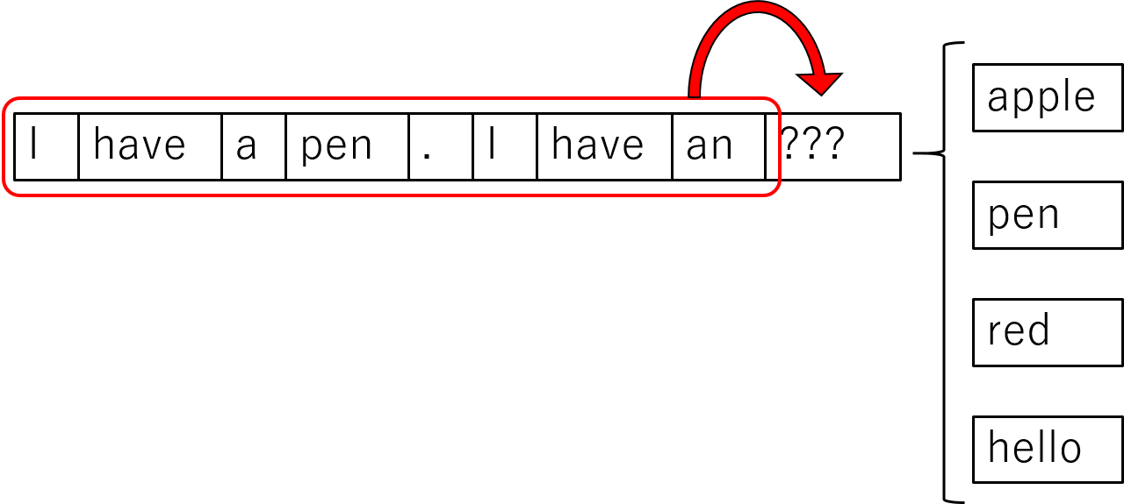
4 INTRO TO PRACTICAL SESSION

Slide 22


PRATICAL SESSION
https://colab.research.google.com/github/ycrao573/rnn-workshop/blob/master/Text%20Generator%20using%20RNN%20Tutorial.ipynb

